Slide 1
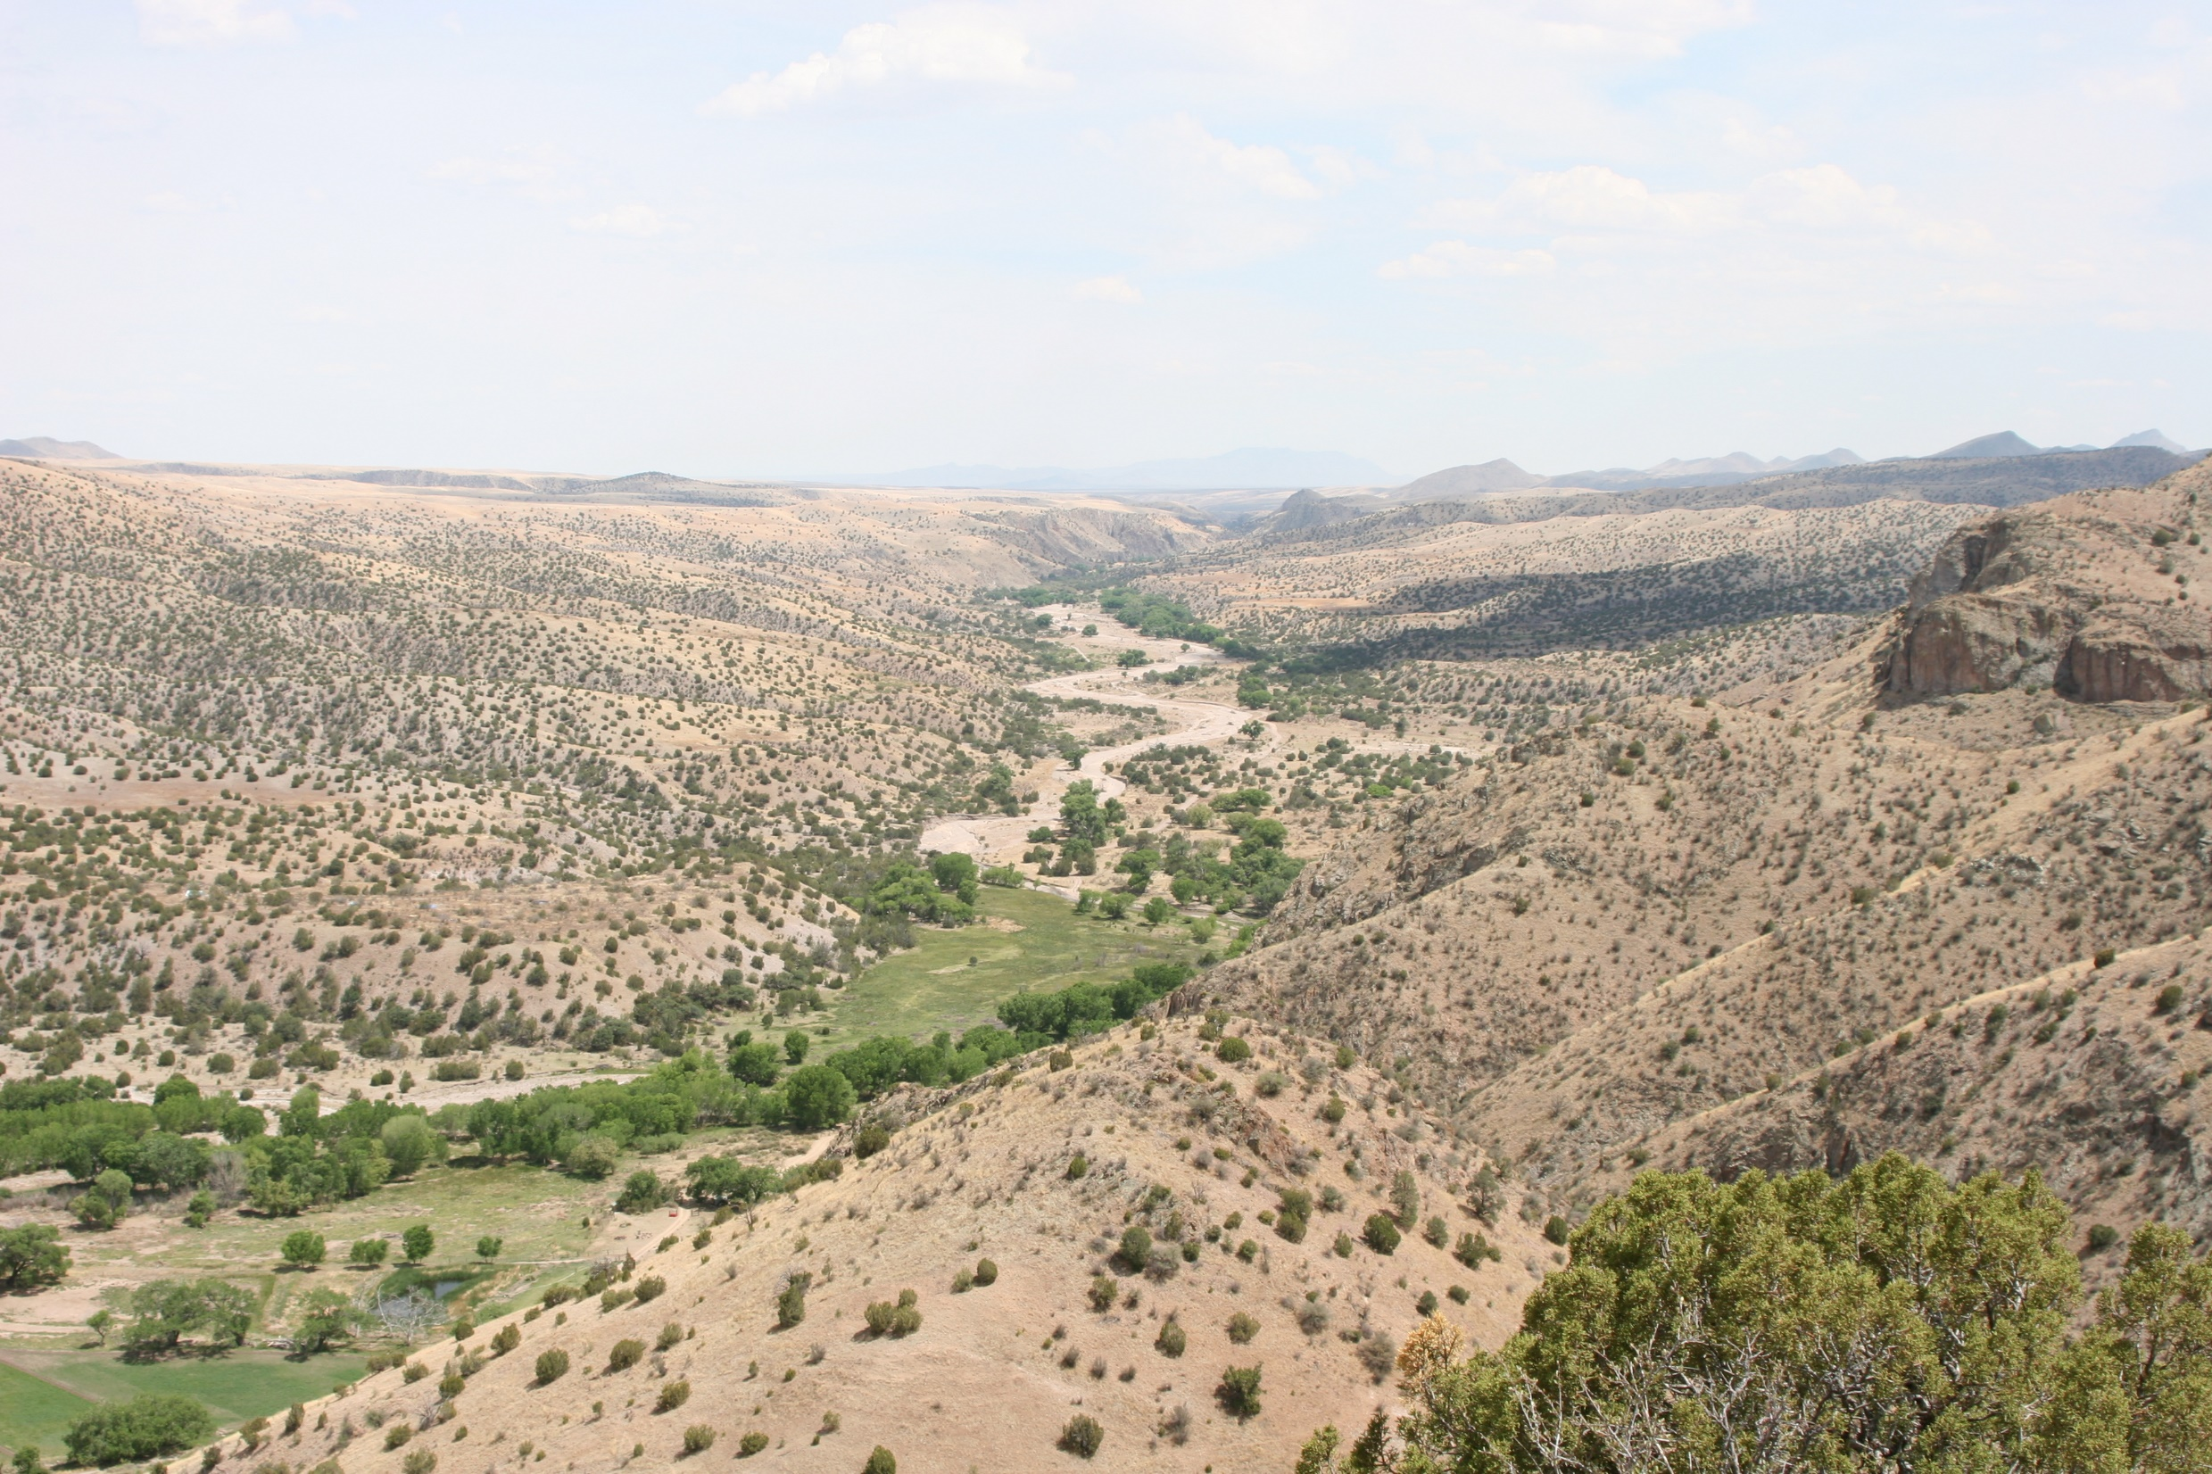
Original
Archaeometry Laboratory
University of Missouri Research Reactor
The Archaeometry Laboratory at the University of Missouri Research Reactor (MURR) provides trace-element analysis (i.e., chemical fingerprinting) of archaeological specimens for the purpose of determining their provenance (geologic source or production location) using the following analytical techniques: neutron activation analysis (NAA), X-ray fluorescence (XRF), and inductively coupled plasma-mass spectrometry (ICP-MS), including laser-ablation ICP-MS (LA-ICP-MS), and multi-collector ICP-MS (MC-ICP-MS). MURR is one of the only archaeometry laboratories in the world providing in-house access to all of these powerful analytical techniques. We specialize in the compositional analysis of archaeological ceramics and chert by NAA, and analysis of obsidian by XRF (and NAA as needed). We also support geochemical research on the petrogenesis of various igneous, metamorphic, and sedimentary rocks. If you have specific questions about our capabilities, please contact us.

Slide 2
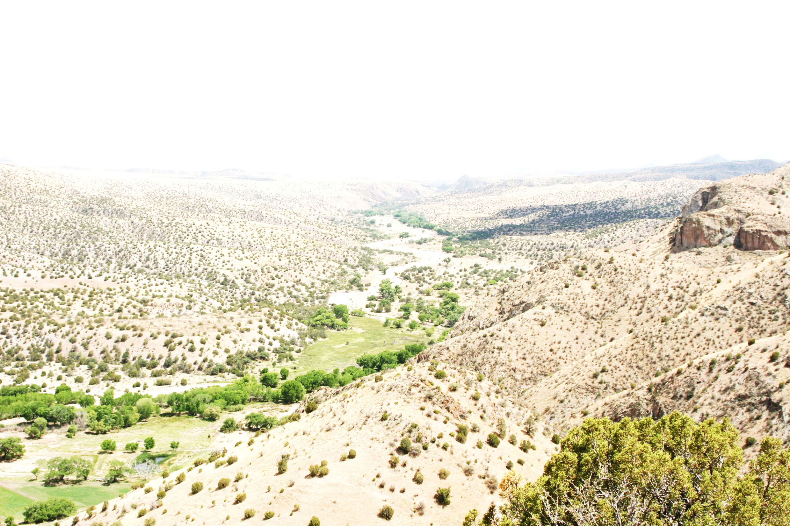
Brightness: +20%
Contrast: +20%
Archaeometry Laboratory
University of Missouri Research Reactor
The Archaeometry Laboratory at the University of Missouri Research Reactor (MURR) provides trace-element analysis (i.e., chemical fingerprinting) of archaeological specimens for the purpose of determining their provenance (geologic source or production location) using the following analytical techniques: neutron activation analysis (NAA), X-ray fluorescence (XRF), and inductively coupled plasma-mass spectrometry (ICP-MS), including laser-ablation ICP-MS (LA-ICP-MS), and multi-collector ICP-MS (MC-ICP-MS). MURR is one of the only archaeometry laboratories in the world providing in-house access to all of these powerful analytical techniques. We specialize in the compositional analysis of archaeological ceramics and chert by NAA, and analysis of obsidian by XRF (and NAA as needed). We also support geochemical research on the petrogenesis of various igneous, metamorphic, and sedimentary rocks. If you have specific questions about our capabilities, please contact us.

Slide 3

Brightness: +20%
Contrast: 0%
Archaeometry Laboratory
University of Missouri Research Reactor
The Archaeometry Laboratory at the University of Missouri Research Reactor (MURR) provides trace-element analysis (i.e., chemical fingerprinting) of archaeological specimens for the purpose of determining their provenance (geologic source or production location) using the following analytical techniques: neutron activation analysis (NAA), X-ray fluorescence (XRF), and inductively coupled plasma-mass spectrometry (ICP-MS), including laser-ablation ICP-MS (LA-ICP-MS), and multi-collector ICP-MS (MC-ICP-MS). MURR is one of the only archaeometry laboratories in the world providing in-house access to all of these powerful analytical techniques. We specialize in the compositional analysis of archaeological ceramics and chert by NAA, and analysis of obsidian by XRF (and NAA as needed). We also support geochemical research on the petrogenesis of various igneous, metamorphic, and sedimentary rocks. If you have specific questions about our capabilities, please contact us.

Slide 4
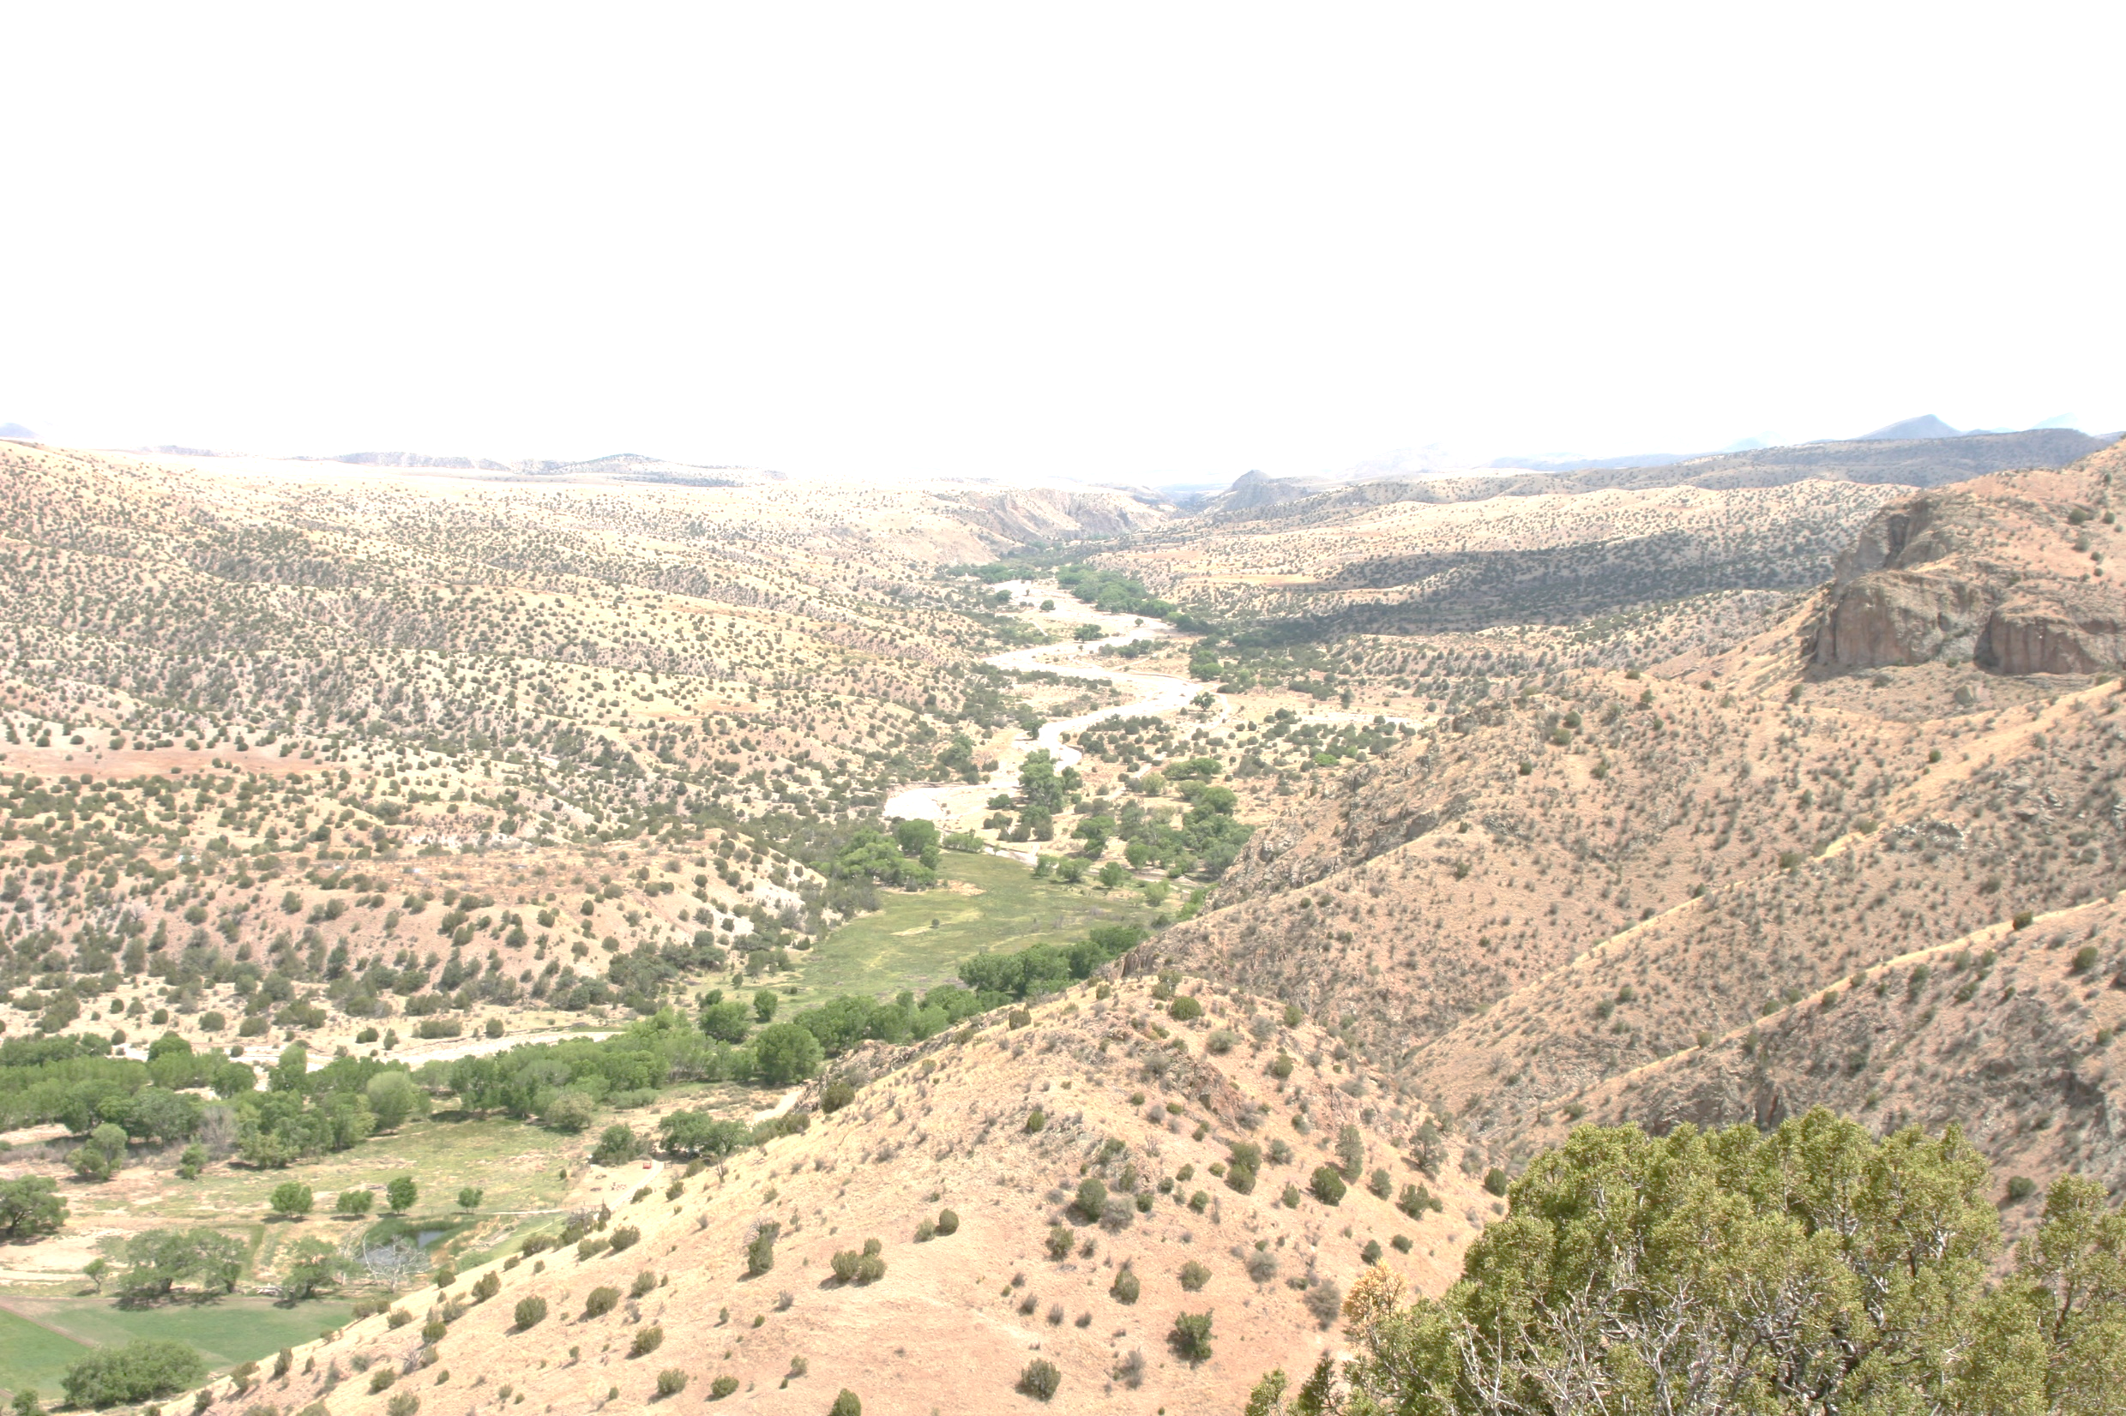
Brightness: +20%
Contrast: -20%
Archaeometry Laboratory
University of Missouri Research Reactor
The Archaeometry Laboratory at the University of Missouri Research Reactor (MURR) provides trace-element analysis (i.e., chemical fingerprinting) of archaeological specimens for the purpose of determining their provenance (geologic source or production location) using the following analytical techniques: neutron activation analysis (NAA), X-ray fluorescence (XRF), and inductively coupled plasma-mass spectrometry (ICP-MS), including laser-ablation ICP-MS (LA-ICP-MS), and multi-collector ICP-MS (MC-ICP-MS). MURR is one of the only archaeometry laboratories in the world providing in-house access to all of these powerful analytical techniques. We specialize in the compositional analysis of archaeological ceramics and chert by NAA, and analysis of obsidian by XRF (and NAA as needed). We also support geochemical research on the petrogenesis of various igneous, metamorphic, and sedimentary rocks. If you have specific questions about our capabilities, please contact us.

Slide 5
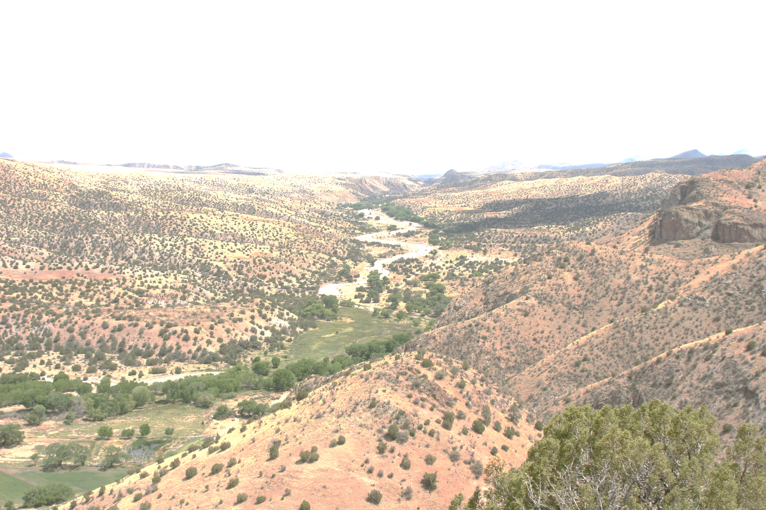
Brightness: +20%
Contrast: -40%
Archaeometry Laboratory
University of Missouri Research Reactor
The Archaeometry Laboratory at the University of Missouri Research Reactor (MURR) provides trace-element analysis (i.e., chemical fingerprinting) of archaeological specimens for the purpose of determining their provenance (geologic source or production location) using the following analytical techniques: neutron activation analysis (NAA), X-ray fluorescence (XRF), and inductively coupled plasma-mass spectrometry (ICP-MS), including laser-ablation ICP-MS (LA-ICP-MS), and multi-collector ICP-MS (MC-ICP-MS). MURR is one of the only archaeometry laboratories in the world providing in-house access to all of these powerful analytical techniques. We specialize in the compositional analysis of archaeological ceramics and chert by NAA, and analysis of obsidian by XRF (and NAA as needed). We also support geochemical research on the petrogenesis of various igneous, metamorphic, and sedimentary rocks. If you have specific questions about our capabilities, please contact us.

